Slide 1
CAMPUS VIEW
Alan Shaji
Anirudh Ajay
Krishnadev P Melevila
Robin George

Slide 2
What is Campus View?
A Web based system to generate the assessment data with given inputs for college accreditation purposes

Slide 3
Progress
Designed the GUI interface
Implemented the Input 1 and Input 2 form as per the excel
Created the code repository on git and pushed upto the current development

Slide 4
To be completed
Connect the DB
Align the form workflow
Implement the CO-PO mapping logic

Slide 5
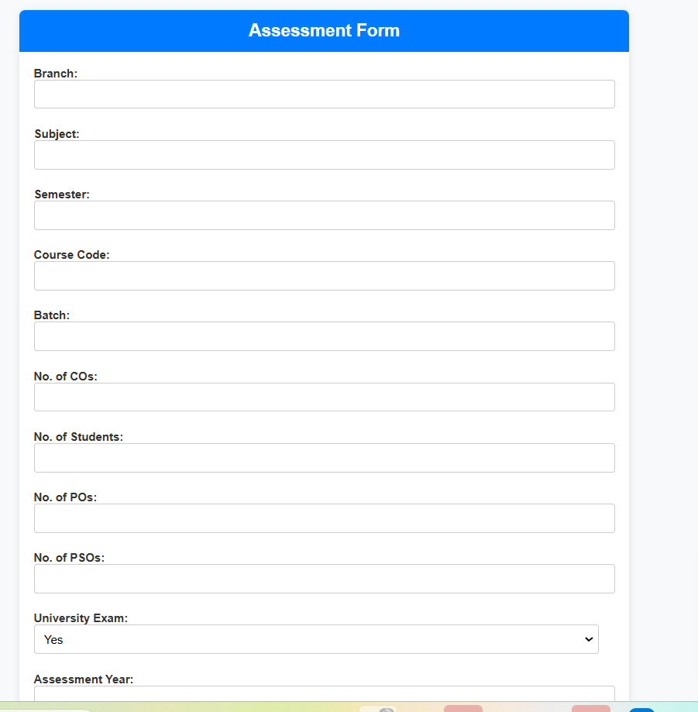
Screenshots

Slide 6
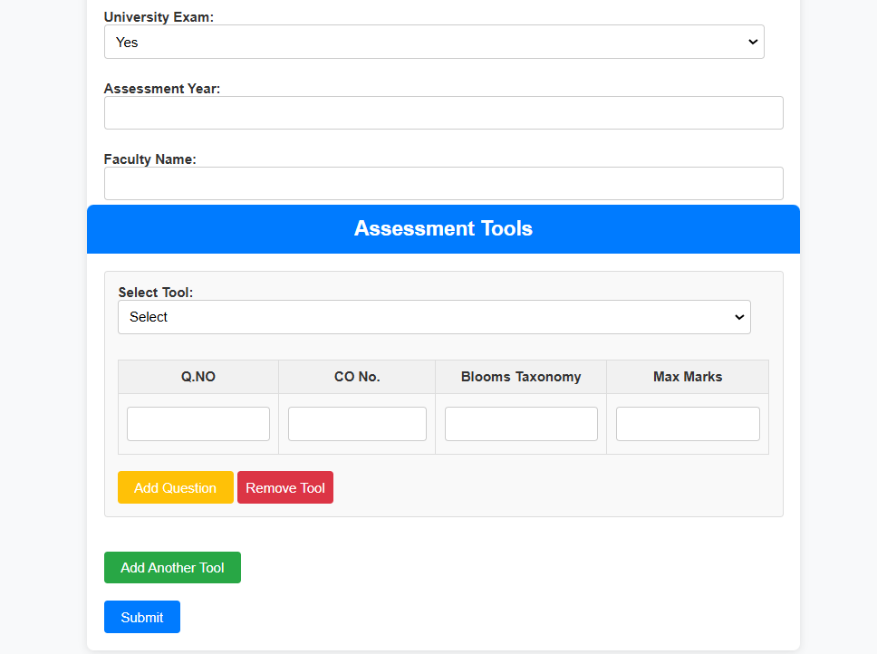

Slide 7
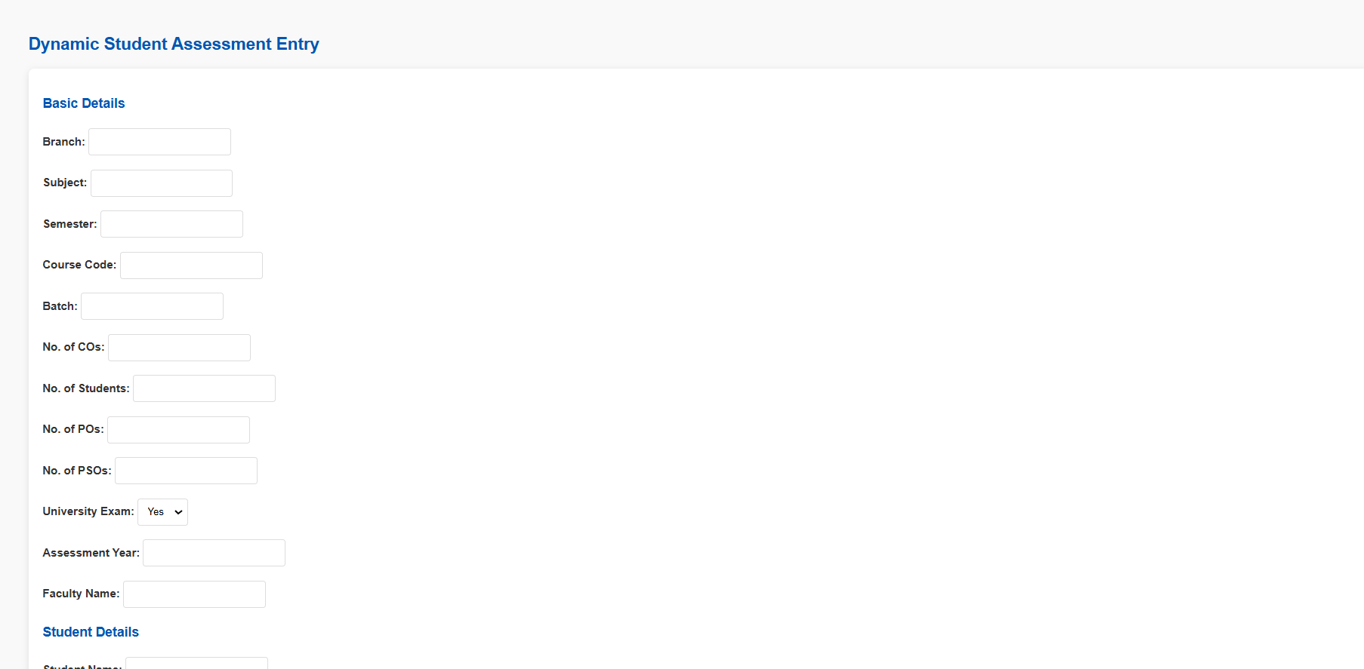

Slide 8
